Slide 1


Slide 2

Notes:
SAP is a leading enterprise software company that provides integrated business solutions, including ERP (Enterprise Resource Planning), to help organizations streamline processes, manage data, and optimize business operations.

Slide 3

Notes:
SAP SuccessFactors is a cloud-based human capital management (HCM) suite offered by SAP, focusing on optimizing HR processes.

Slide 4
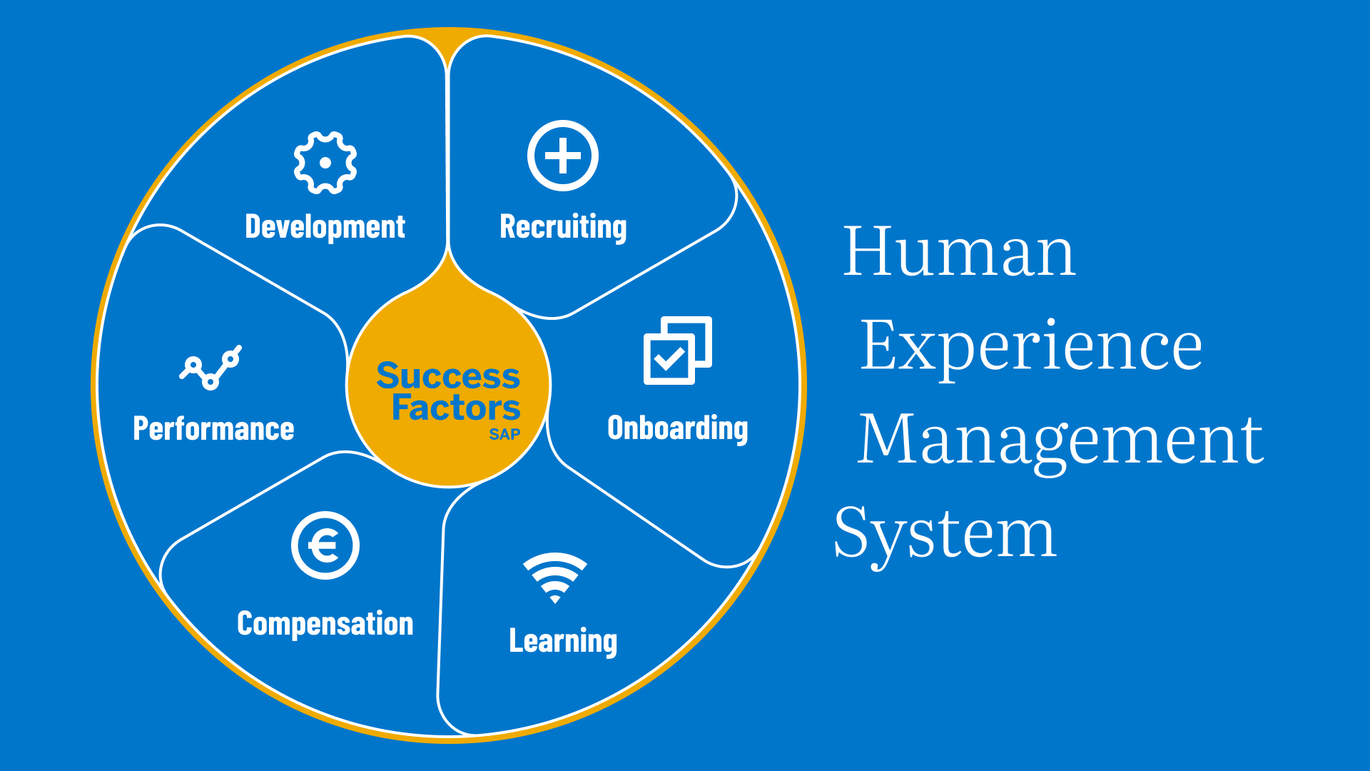
Notes:
It encompasses a range of modules such as payroll system, employee performance, learning management, on- and offboarding process and workforce analytics.

Slide 5

Notes:
My project aims to enhance SAP SuccessFactors by introducing a predictive feature. That shows if an employee is about to quit.

Slide 6

Notes:
When it comes to employee turnover, companies have to face a lot of challenges.

Slide 7

Notes:
Attrition can impact productivity, morale, and costs.

Slide 8
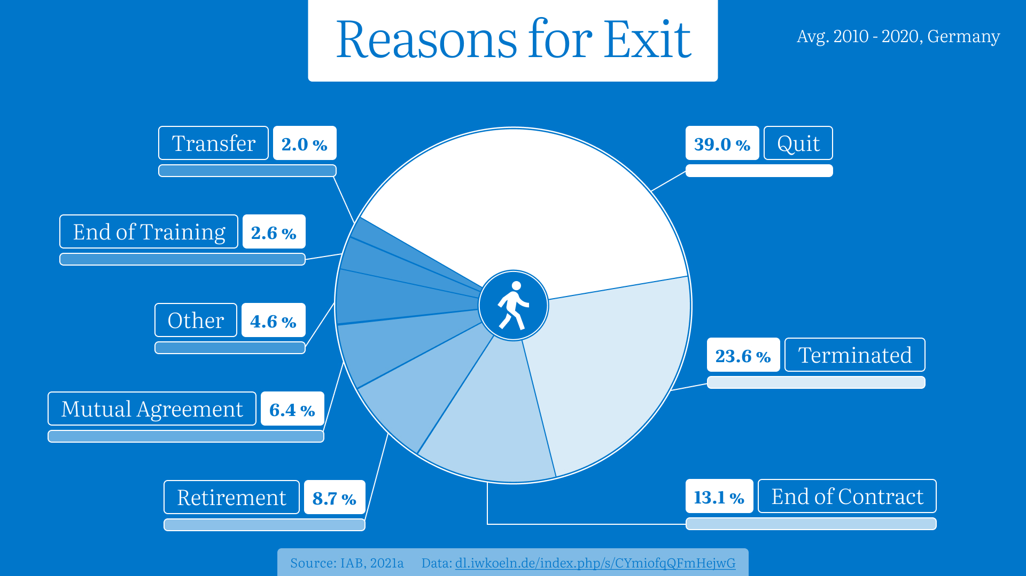
Notes:
Here are average percentages of attrition reasons from 2010 to 2020 in Germany. As we can see the majority class here is voluntary termination. So, most people quit on their own and it’s better to know why.

Slide 9

Notes:
Predicting employee departures can help in workforce planning, cost reduction, and maintaining a positive workplace culture.

Slide 10

Notes:
The advantage of SuccessFactors is their accessibility to the data. Everything is stored in one place.

Slide 11
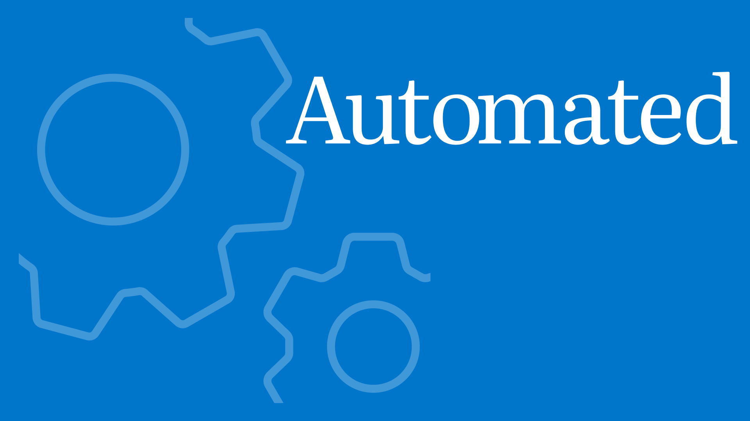
Notes:
It makes the process of data collection easy and fast.

Slide 12
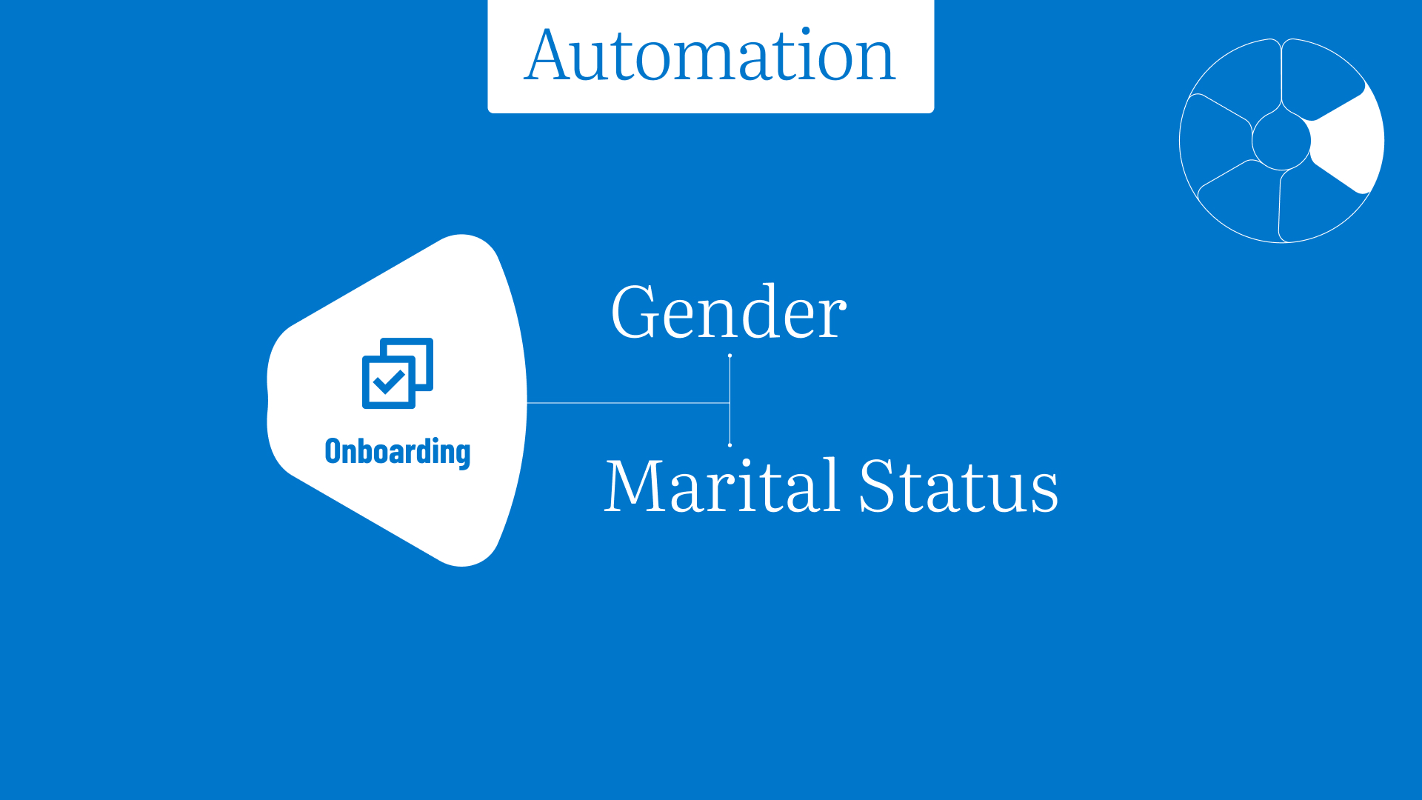
Notes:
For example, in module ‘Onboarding’ we can get data about employee gender and marital status.

Slide 13
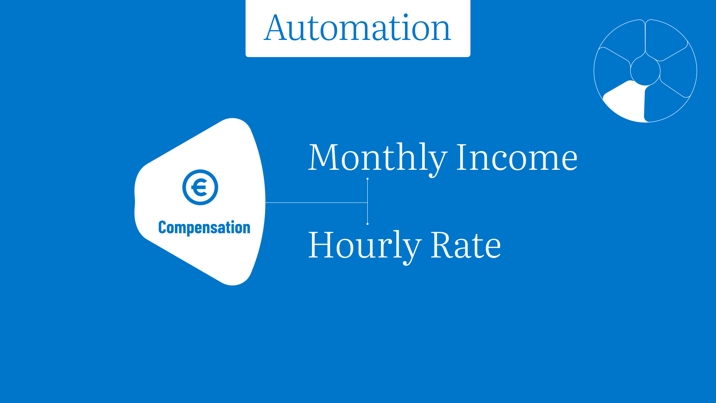
Notes:
In payroll system – information about monthly income and hourly rate

Slide 14
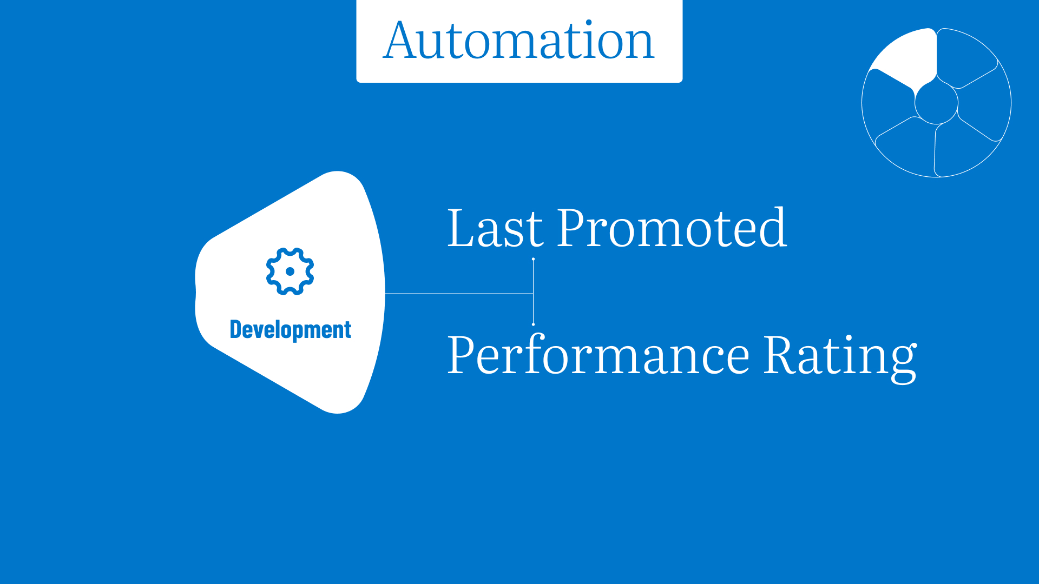
Notes:
In the development module, we can gather information about the last promotion and performance rating

Slide 15
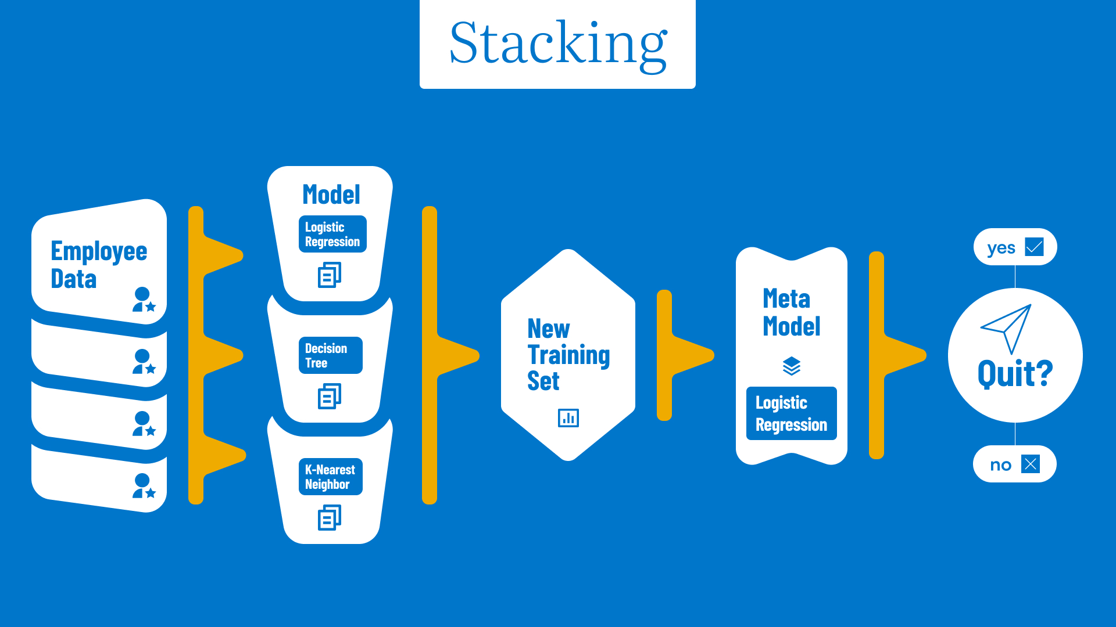
Notes:
This is how the algorithm makes predictions. After cleaning and preparing the data (e.g. handling the outliers, encoding categorical variables, standardizing numerical variables and so on) I built three models: logistic regression, decision tree and KNN model, then using staking method I trained a meta model and, in the end, we get a prediction if a particular employee will quit.

Slide 16
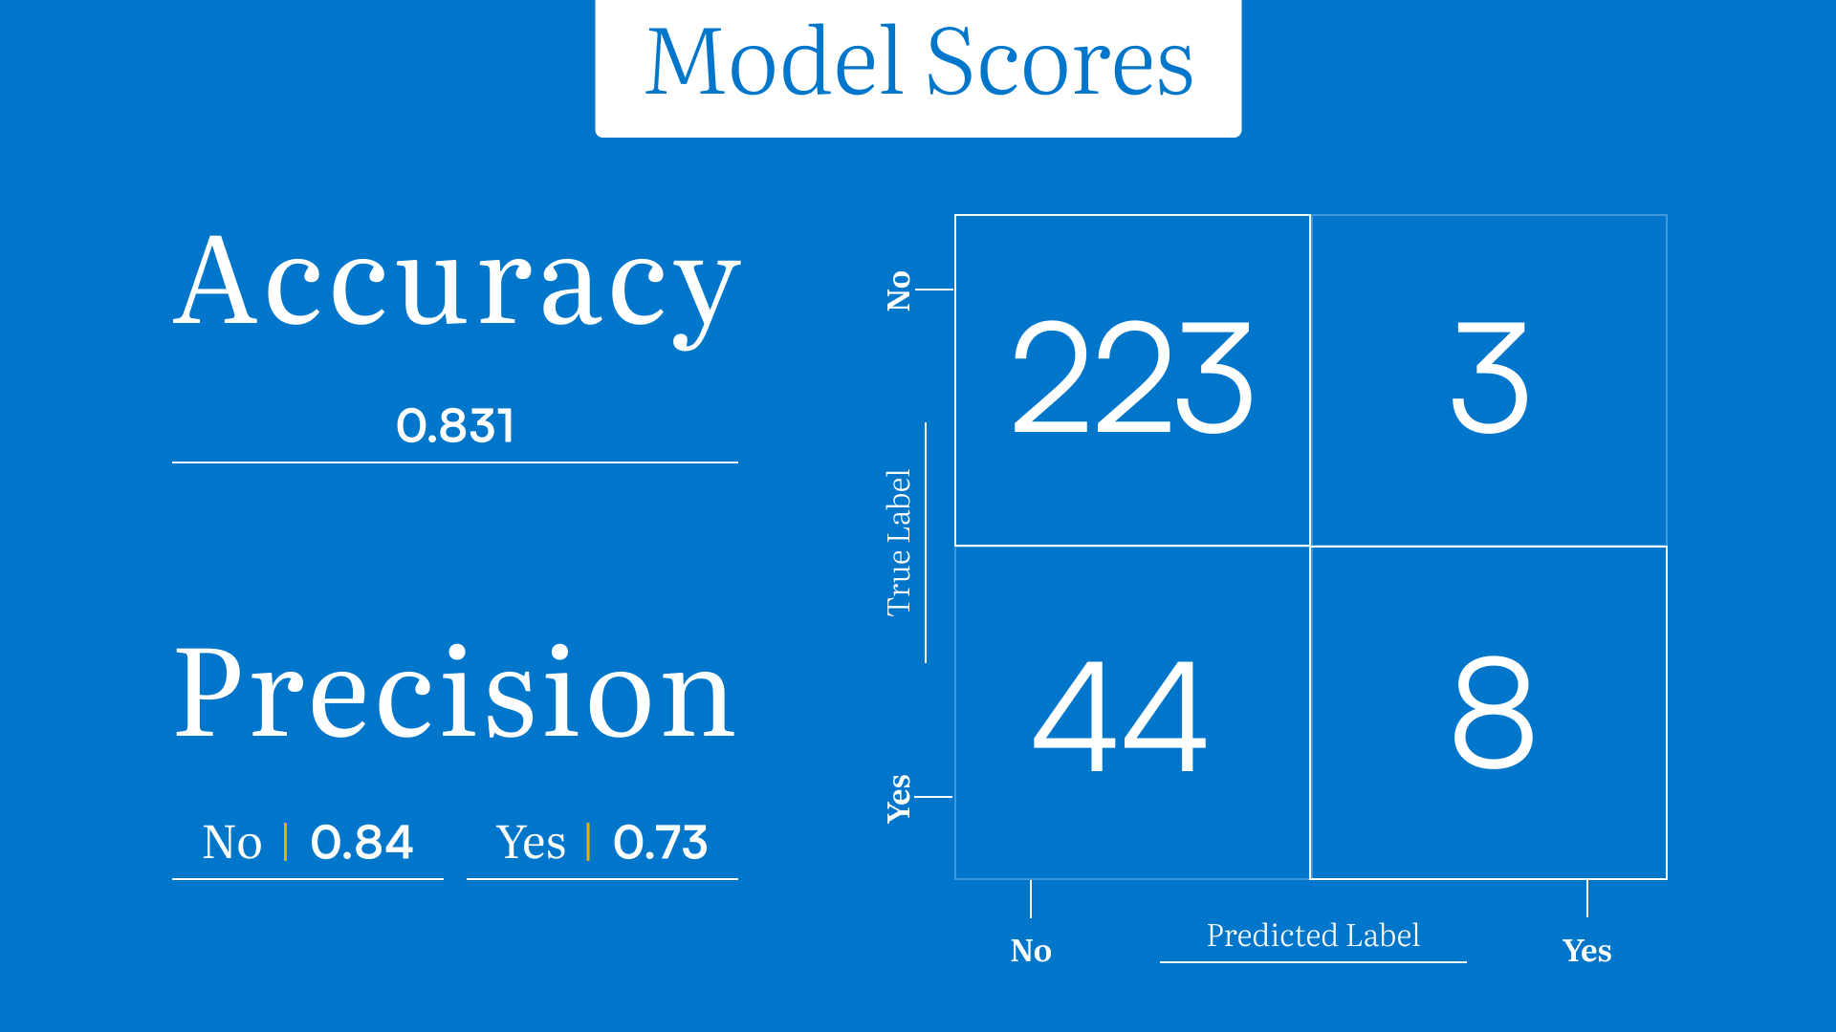

Slide 17

Notes:
These are the key features that I got with the algorithm. Marital status, job satisfaction and educational field.

Slide 18

Notes:
So, what is the use of these features for the users, users will be the HR managers.

Slide 19
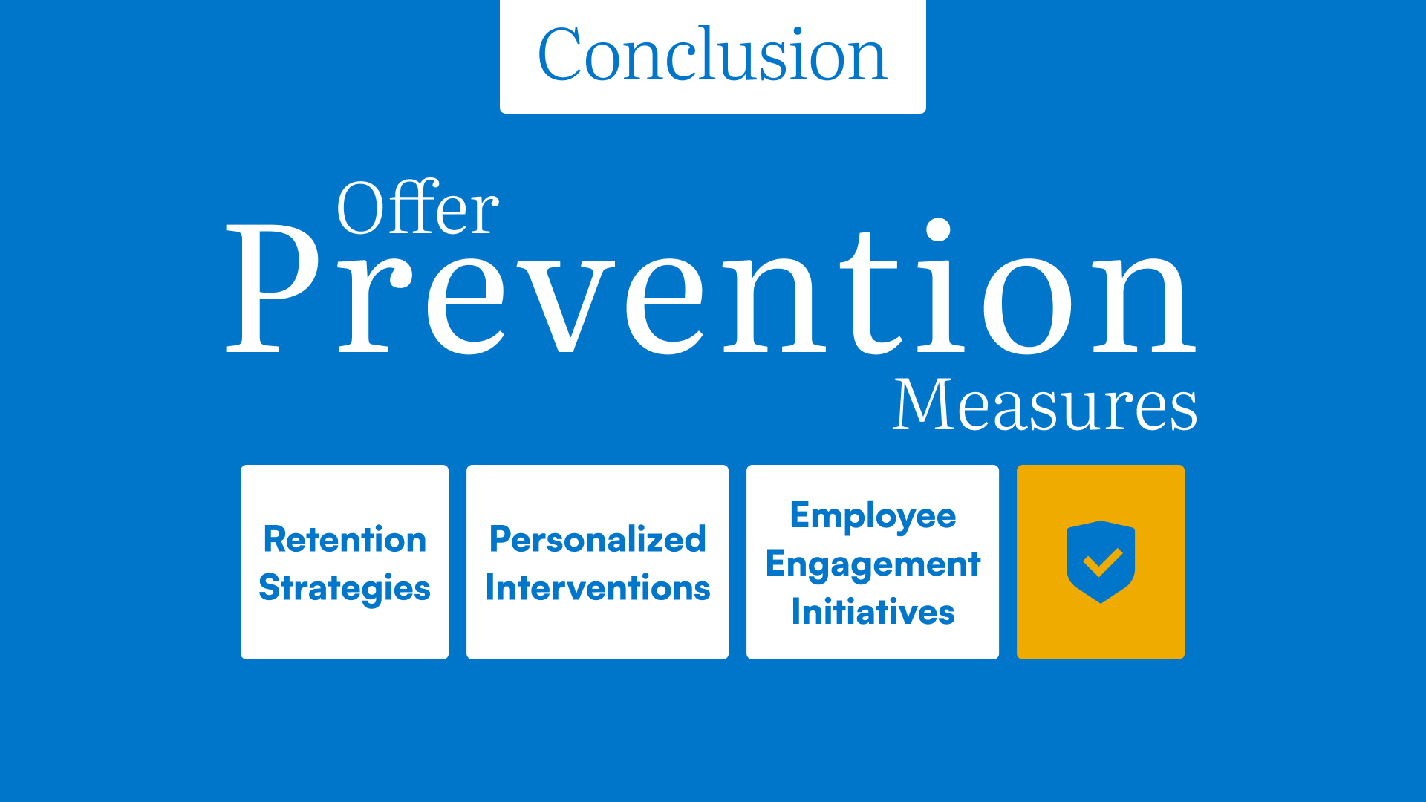
Notes:
By implementation, this feature helps the HR manager to offer prevention measures. Such as development of retention strategies, making personalized interventions and creating employee engagement initiatives. Of course, these measures depend on each company.

Slide 20


